Slide 1

vCARE AMBULANCE AID PROVIDING ANDROID APPLICATION

Slide 2
WHY DO WE NEED THIS APP?
In largely populated countries like India, due to huge traffic lags and lack of ambulance services in government sector, so people rely mainly on private ambulance services which are quite expensive as well as mismanaged.
Using this app, we have integrated all the ambulance services available near the affected person, so that the person may get earliest possible medical aid.
Further in a nutshell, we may conclude that we are providing a single platform to all the private as well as government ambulance services present and also to anyone who wishes to volunteer and register himself as an ambulance service provider.

Slide 3
TECHNOLOGIES USED:
Google firebase:
Firebase gives you functionality like analytics, databases, messaging and crash reporting so you can move quickly and focus on your users.
It provides features like authentication,
Real time database and crash reporting.

Slide 4
2) MIT App Inventor:
App Inventor lets you develop applications for Android phones using a web browser and either a connected phone or emulator.
3) API S USED:
Way2sms messaging API to develop an OTP generation system to make the register system more secure.

Slide 5
4) Sensors Used:
Barcode and QR code scanner: This sensor is used for unique identification of the ambulance driver using his driving license.
Accelerometer sensor: This sensor has been used in the application for detecting the vibrations caused to the phone in the jerk conditions especially road accidents.

Slide 6
WORKFLOW OF THE ANDROID APPLICATION:
Registration of Ambulances
General app user will get the locations of nearest online ambulances.
The nearest online ambulance will be notified.
In case of accidents or crime cases police involvement can be directly made through this app.
In case of driving, a safe mode is also included in the interface of the app. This allows the app to automatically send SOS messages to the contact number entered by the user.

Slide 7
AUTOMATIC ACCIDENT DETECTION
USING ACCELEROMETER:
The sensor in our phones is a 3-axis accelerometer sensor (MMA7660FC) which is
capable of finding different physical changes like “tilt”, “tap”, “shake” etc. Advantage of this sensor is it can sense the physical conditions in all the three directions (i.e.,3 Axis).
ALGORITHM DEVELOPED:
1) Initialise the GSM module.
2)The current locations are fetched.
3) After the conditions for accident detection are met the notification is sent to the nearest active ambulance.
Source: International Journal of Science, Engineering and Technology Research, Volume 3, Issue 9, September 2014 ISSN: 2278 – 7798 All Rights Reserved © 2014 IJSETR 2359 ACCIDENT DETECTION DEPENDING ON THE VEHICLE POSITION AND VEHICLE THEFT TRACKING, REPORTING SYSTEMS Modugula Ravikanth Reddy† , J.Tulasi ♀ Electronics and Communication Engineering Department, St.Mary’s Group of institutions ,Guntur, India

Slide 8
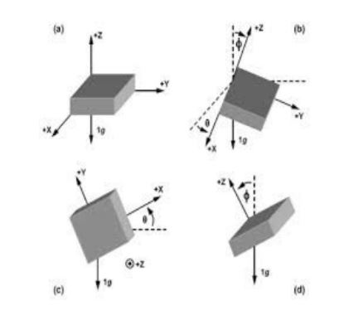
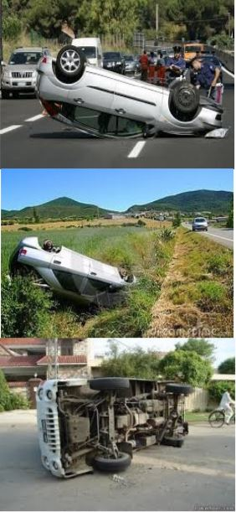
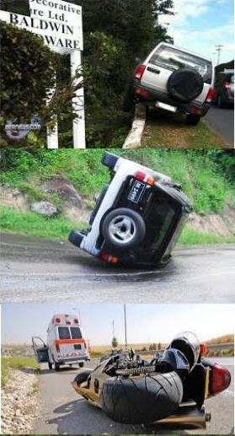
Fig: Different angles in which the vehicle can tilt in the accident conditions
Fig: Various accident conditions

Slide 9
WHAT ELSE CAN BE UPDATED IN THE APP:
We can create a database for the ambulance driver as well which will help him to drive the patient to the nearest hospital depending upon the condition of the patient.

Slide 10
THANK YOU

